Slide 1


Slide 2

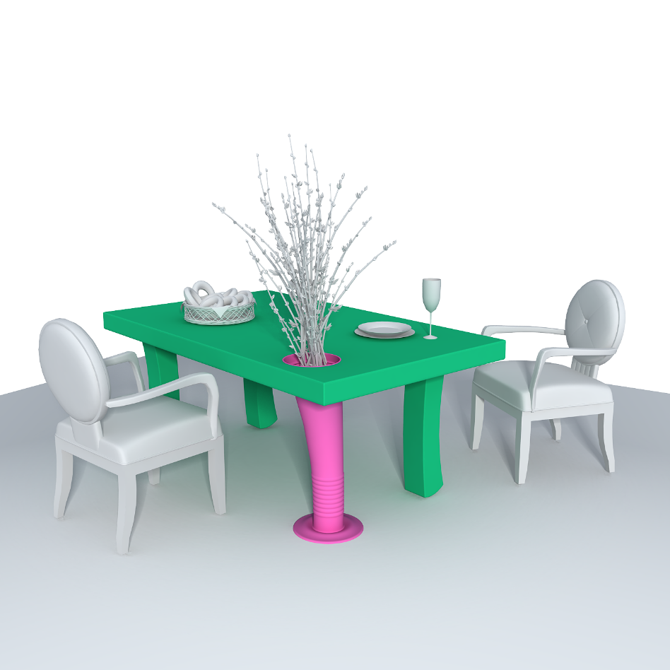





Learning How Objects Function
via Co-Analysis of Interactions
Ruizhen Hu¹ Oliver van Kaick² Bojian Wu³
Hui Huang^{1,3} Ariel Shamir⁴ Hao Zhang⁵
¹ Shenzhen University
² Carleton University
³ SIAT
⁴ The Interdisciplinary Center
⁵ Simon Fraser University

Slide 3
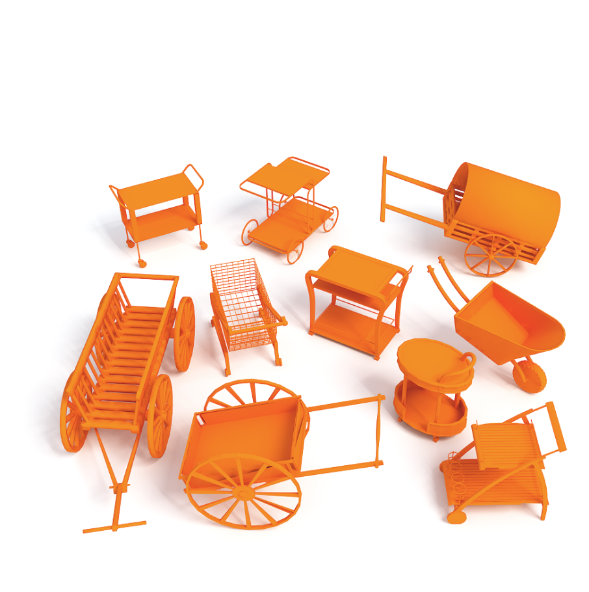
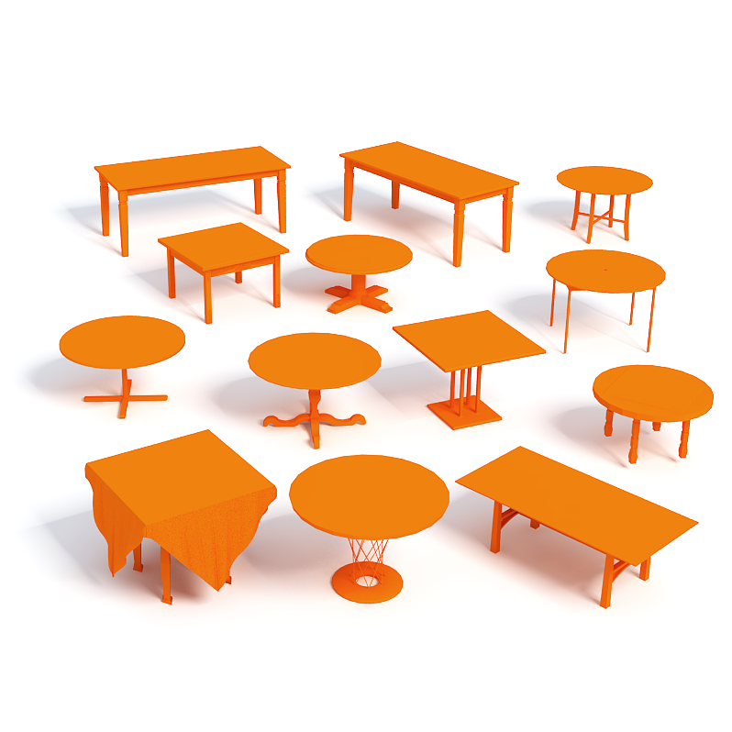
Motivation
Object functionality
Essential categorization of objects
Notes:
Understanding the functionalities of 3D shapes [CLICK] is of great importance in shape analysis and geometric modeling.
It has been stipulated that the essential categorization of objects is by functionality
for example, those two classes of shapes are defined by their functionality even though their geometry differ a lot.

Slide 4
Motivation
Object functionality
Essential categorization of objects
Basic requirement for creating or customizing
Notes:
As well, the most basic requirement for creating or customizing a 3D product is that the object must serve its intended functional purpose.

Slide 5

Goal
Learn how objects function
A functionality model for an object category
Object category
Functionality model
Notes:
In this work, we are interested in learning how objects function,
more specifically we would like to learn a functionality model for an object category

Slide 6
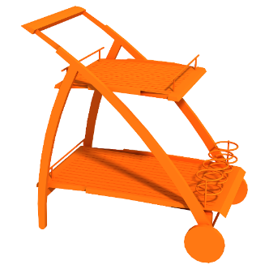

Goal
Learn how objects function
A functionality model for an object category
Score = 0.96
Score = 0.72
Functionality model
Functionality prediction
Notes:
And use it for prediction and other functionality-aware applications

Slide 7
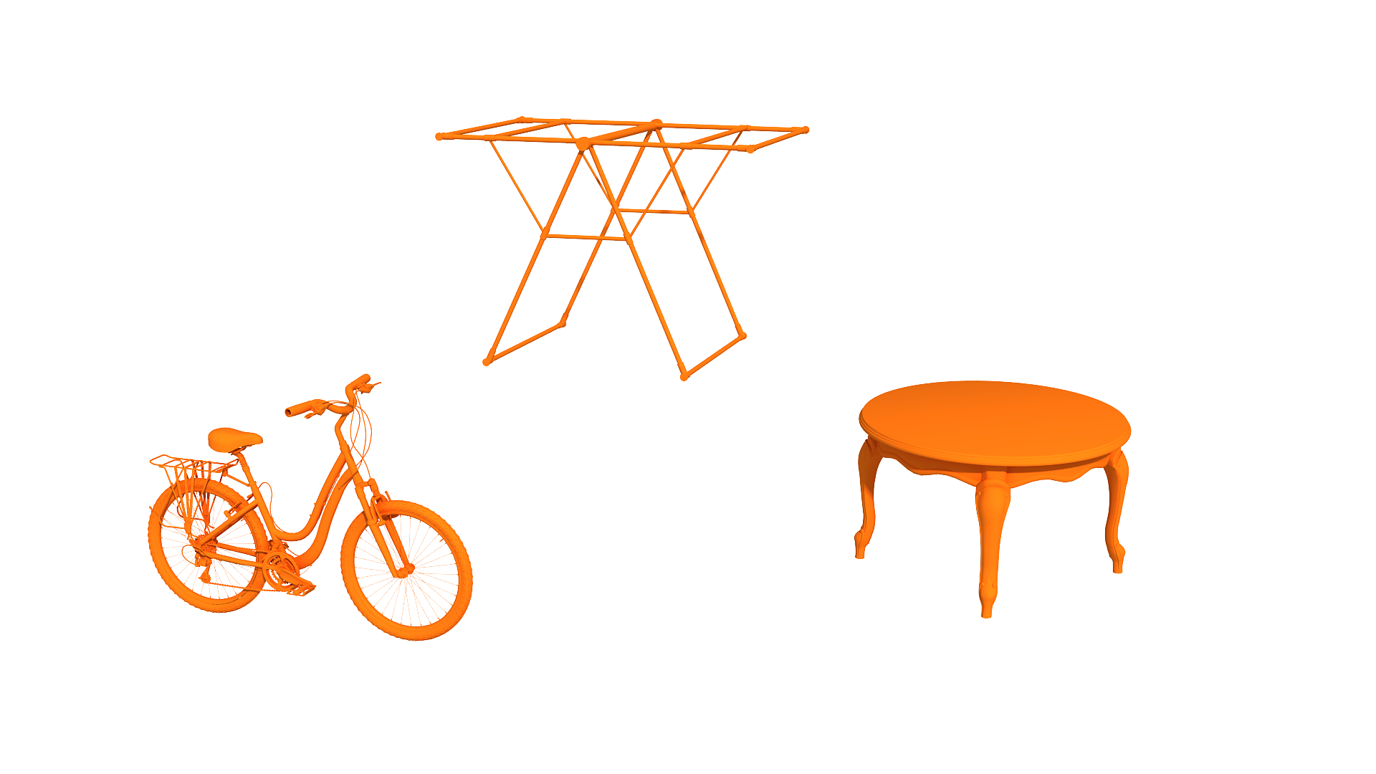
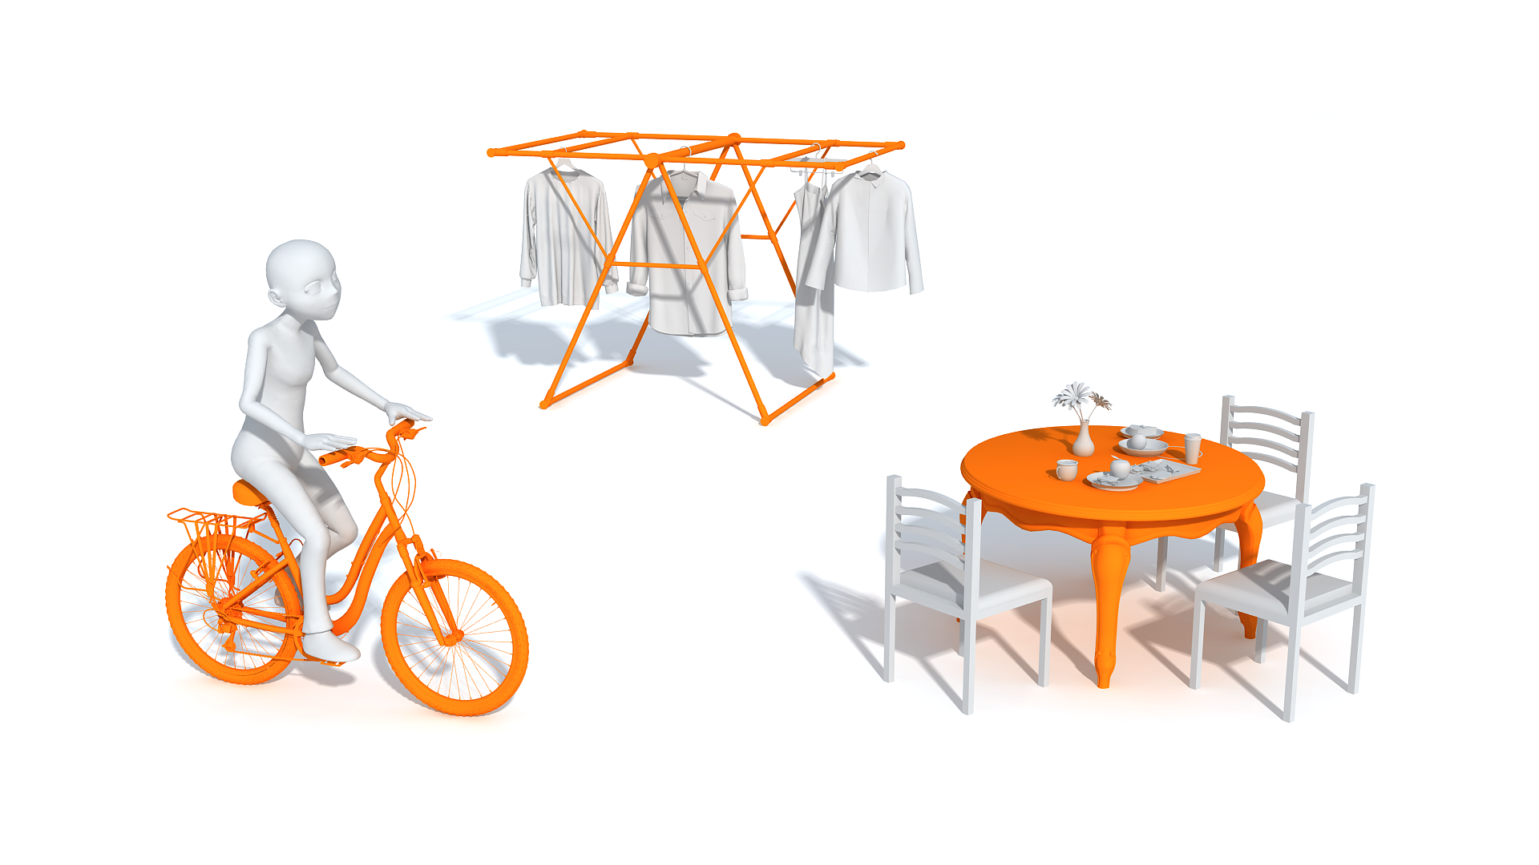
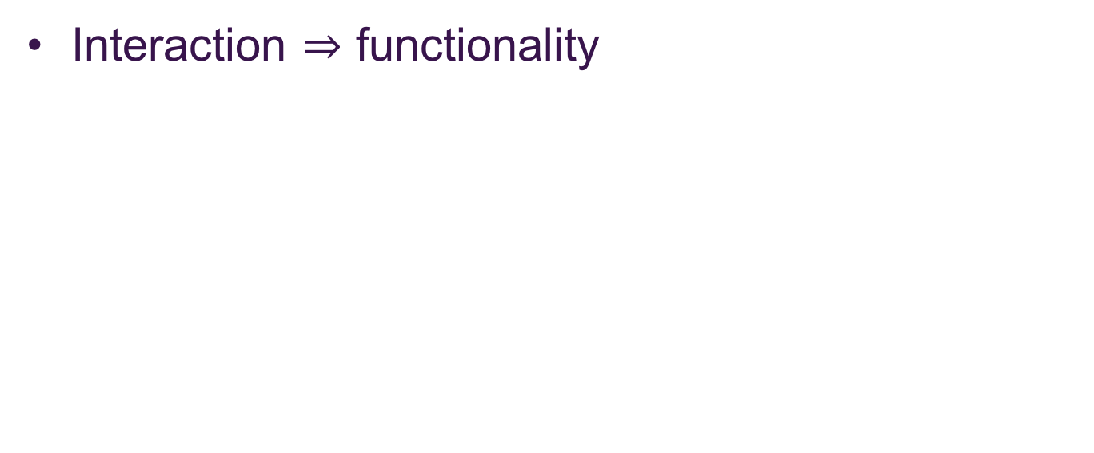
Key observation
Interaction $⇒$ functionality
Scene context
Notes:
Our key observation is that the way of how an object [CLICK] interact with other objects in the given scene context [CLICK] reflects its functionality

Slide 8
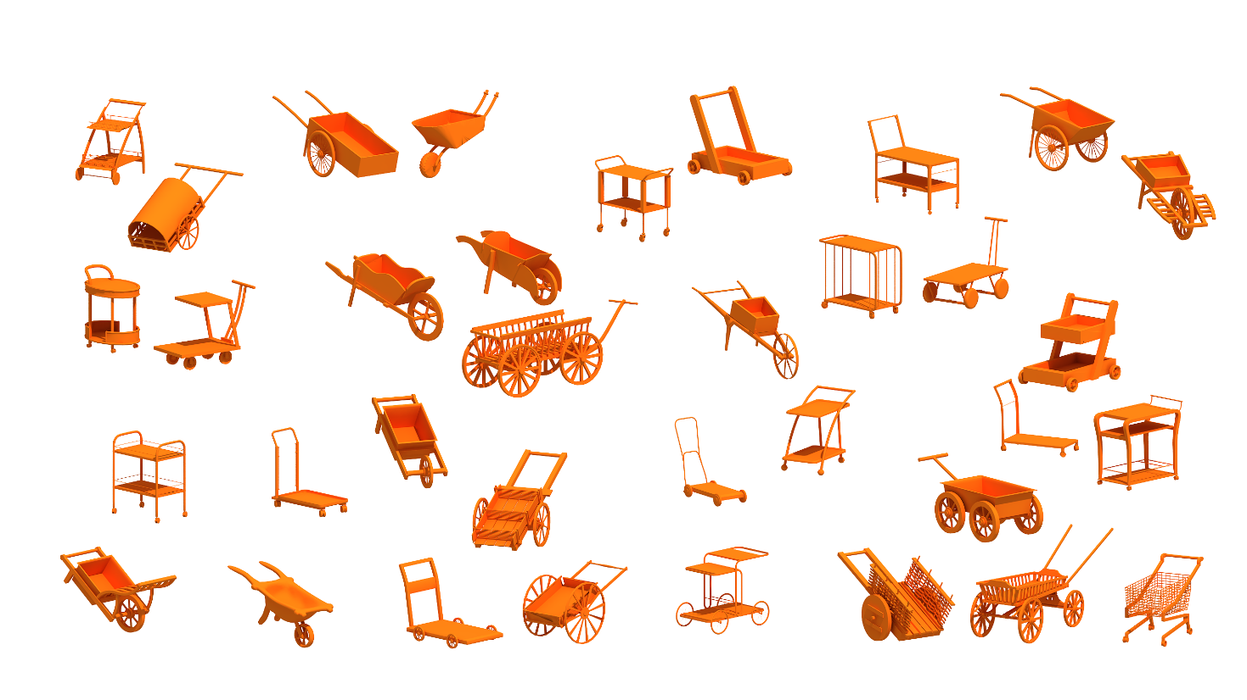
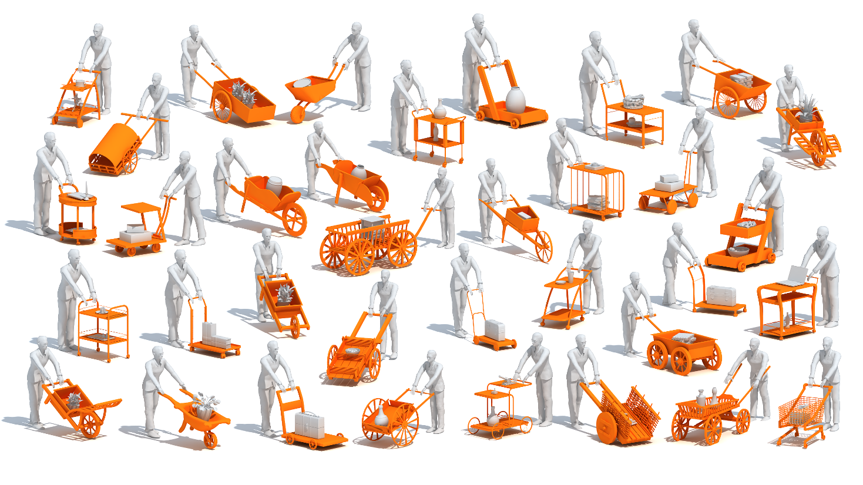
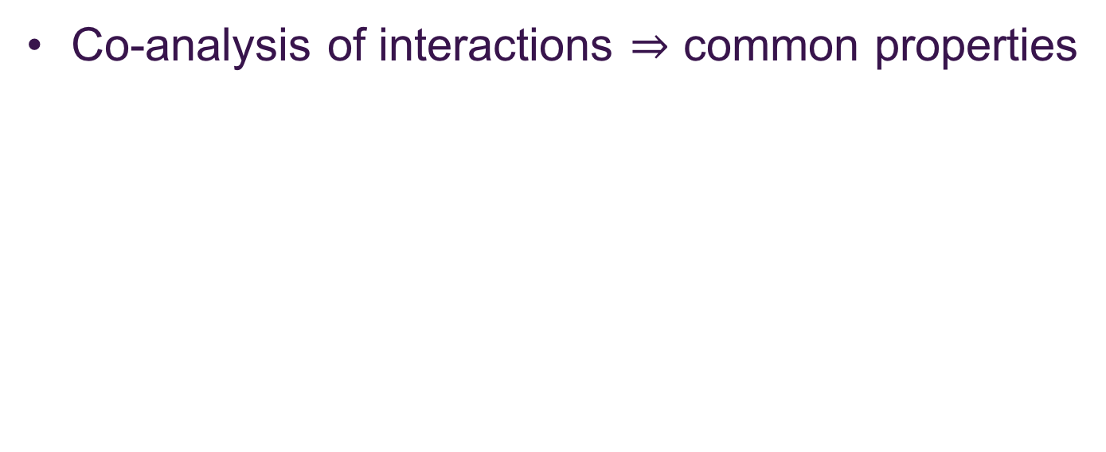
Key observation
Co-analysis of interactions $⇒$ common properties
Notes:
So instead of co-analyzing a set of isolated shapes,
all the objects are provided in scene context.
and via co-analysis of the interactions, we extract the common functionality-related properties shared the objects.

Slide 9
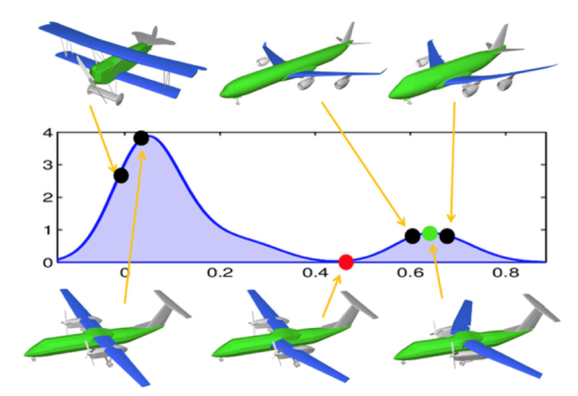
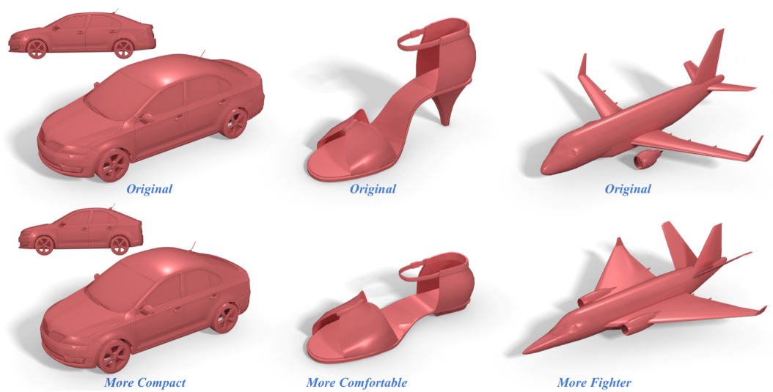
Previous works
Co-analysis of shape collections
[Fish et al. 2014]
[Yumer et al. 2015]
Notes:
There are some previous works on structure-aware analysis which generalize shape structures by learning statistics of part relations or surfaces via co-analyses,
but typically, the analysis is either insufficient or indirect for acquiring a functional understanding of shapes.

Slide 10
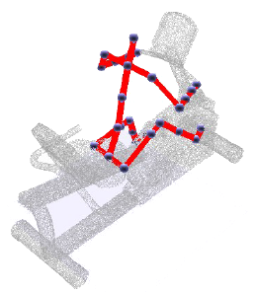
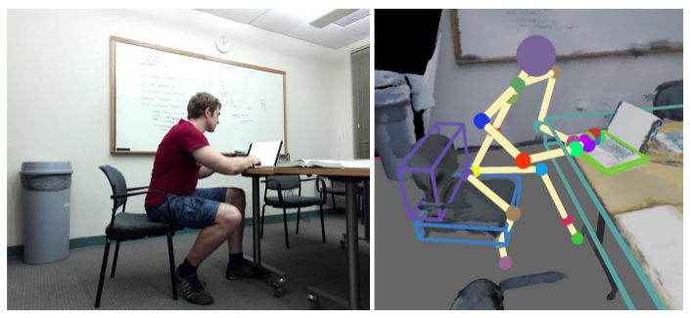
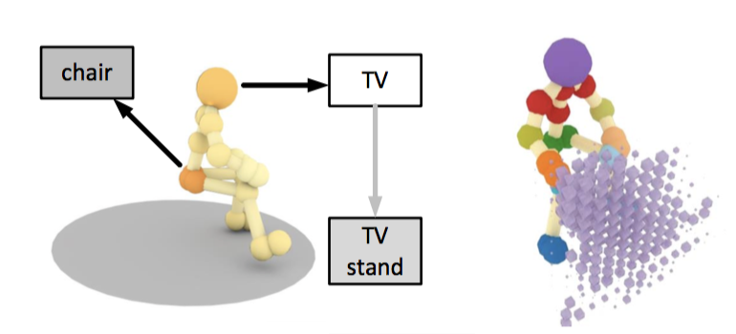
Previous works
Human-object interactions
[Kim et al. 2014]
[Savva et al. 2014]
[Savva et al. 2016]
Notes:
There are also some recent works which characterize functionalities more directly with an agent, most likely a human, interacting with objects.
However, on a more conceptual level, how an object functions is not always well reflected by interactions with human poses.

Slide 11
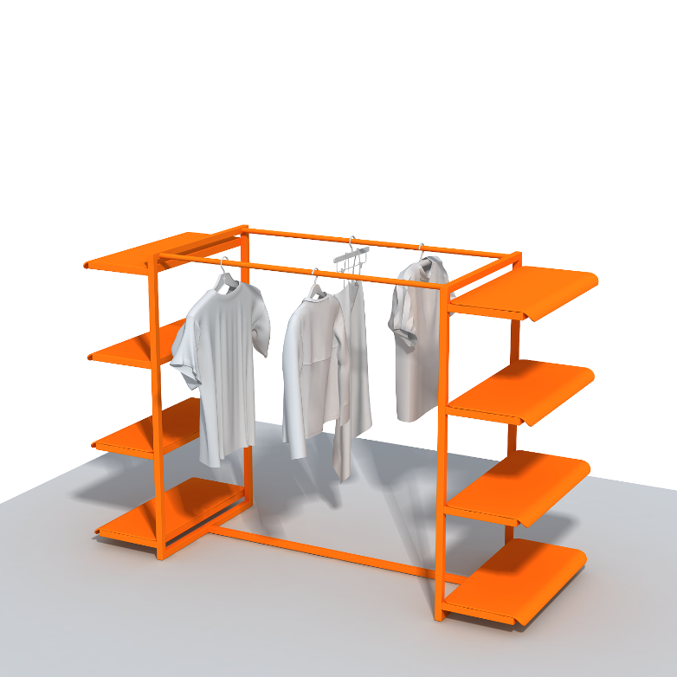


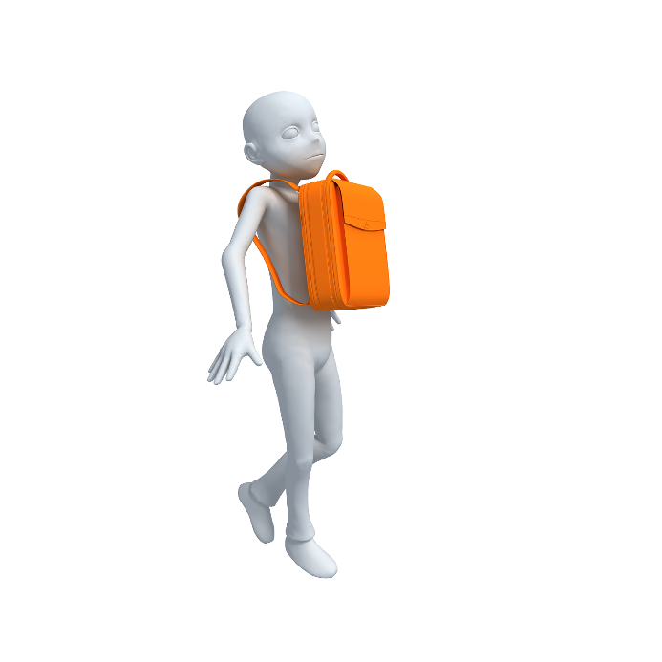

Previous works
Human-object interactions
No human interaction
Large human pose variations
Notes:
For example, consider a drying rack with hanging laundry; there is no human interaction involved.
Even if an object is designed to be directly used by humans, human poses alone cannot always distinguish its functionality from others. For example, a human can carry a backpack with all kinds of different poses.

Slide 12
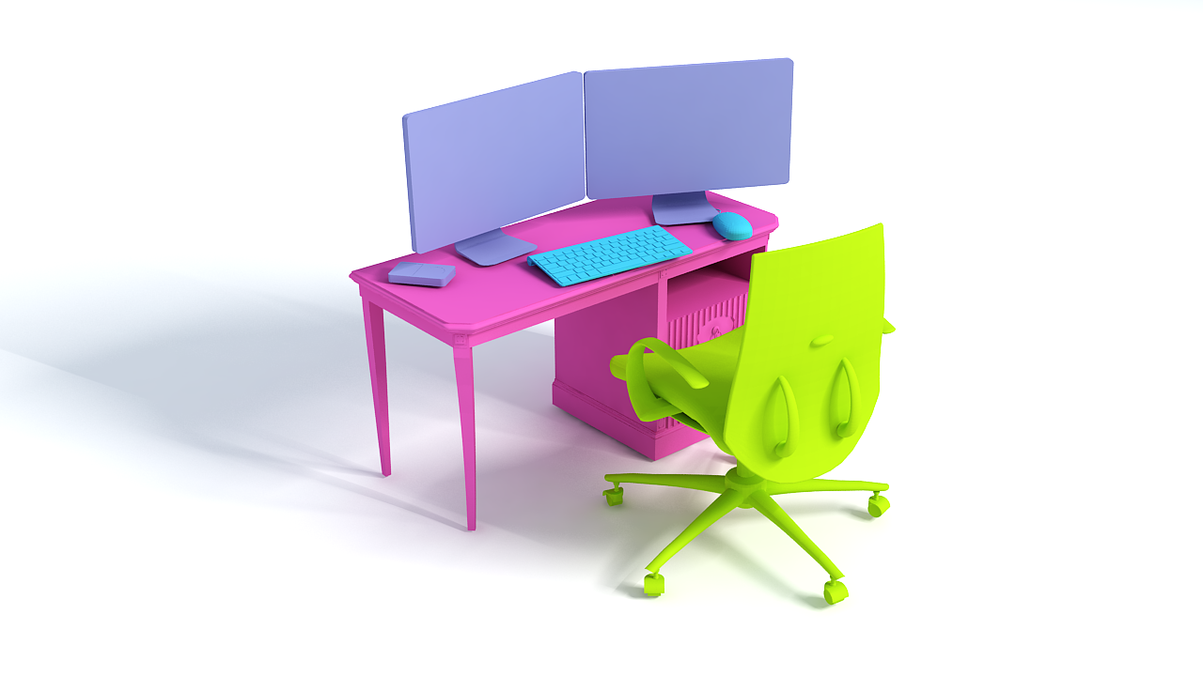
Previous works
Interaction Context (ICON) [Hu et al. 2015]
Central object
Notes:
So our functional co-analysis builds on the work we presented last year: ICON,
which provides a context-based shape descriptor for a single central object given in a scene context.

Slide 13
Our contribution
Functionality model of an object category
Functional understanding of shapes in isolation
No context needed
No segmentation required
Various functionality-aware applications
Functional similarity measure
Functionality exploration
Functionality-guided modeling
Notes:
Based on ICON, in this work we take one step further to learn the functionality of an object category.
Which enables functional understanding of shapes in isolation without any kind of segmentations and various functionality-aware applications like functional similarity measure, functionality exploration, functionality-guided modeling

Slide 14
Functionality model
Notes:
Now I will give more details about our functionality model construction and prediction

Slide 15
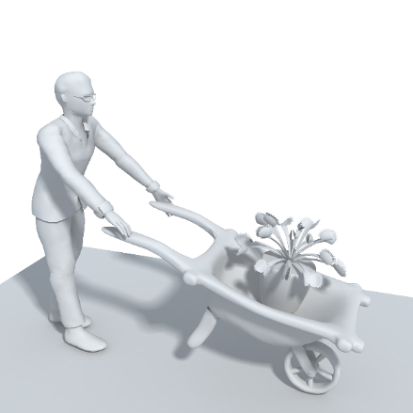
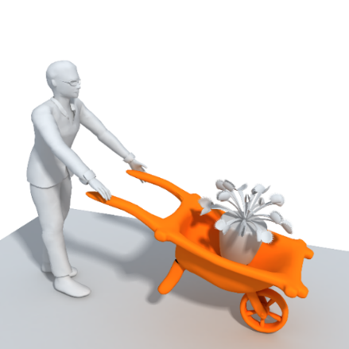
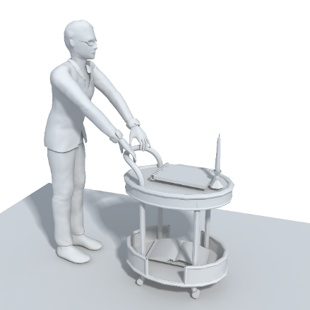
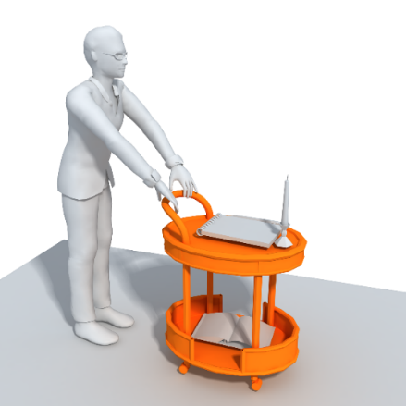
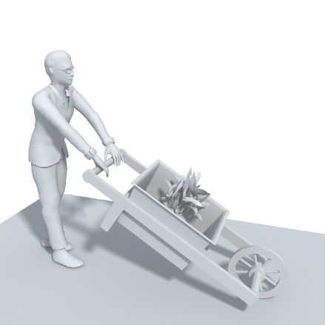
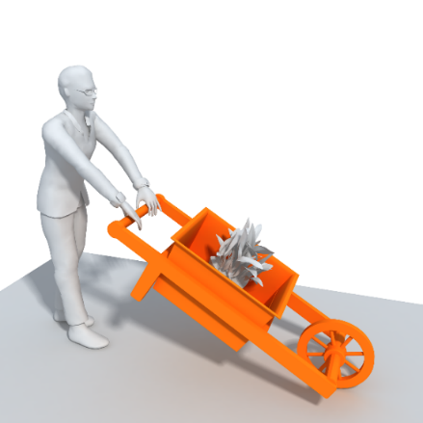
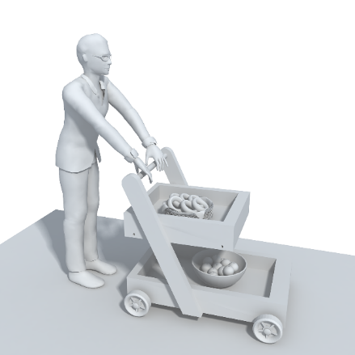
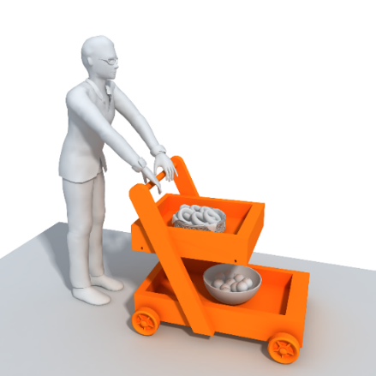
Shape collection
Central object
Notes:
We take as input a set of objects of the same category in the context of a scene.
Each such objects is shown here in orange and referred as the central objects,
while other interacting objects in the scene are gray

Slide 16
ICON

Slide 17
ICON
Notes:
We start by extracting the ICON descriptor to represent the interactions in each scene
which organizes the interactions between a central object and other objects into a hierarchy.

Slide 18

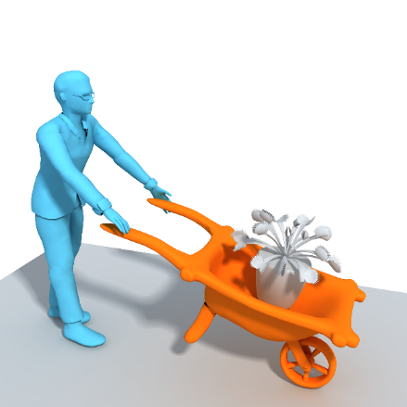
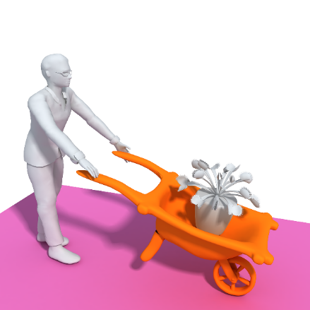
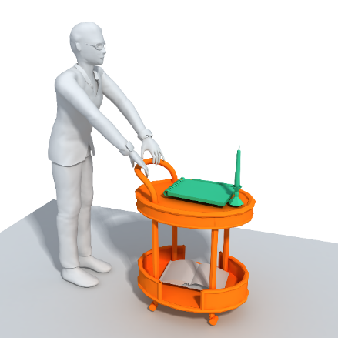
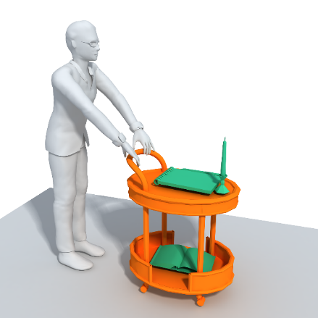
ICON
Notes:
Leaf nodes of this hierarchy correspond to interactions with individual objects.
And intermediate nodes group multiple similar interactions together.

Slide 19

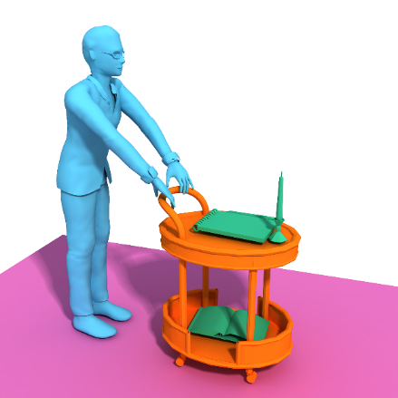
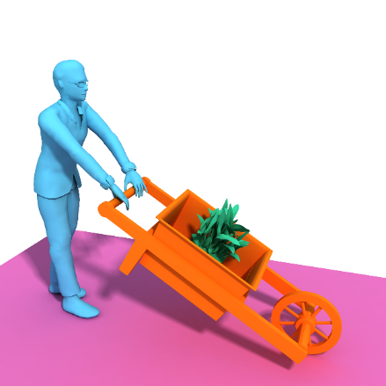
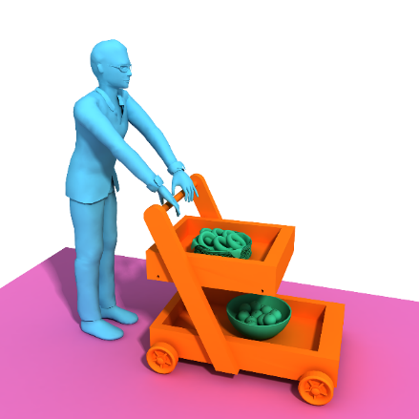
Correspondence
Notes:
We then build a correspondence between all the hierarchies in the set based on ICON similarity measure
and get different types of interactions, here shown in different colors.
Using this correspondence, we are able to group together all the patches corresponding to the same type of interaction in the entire category.

Slide 20





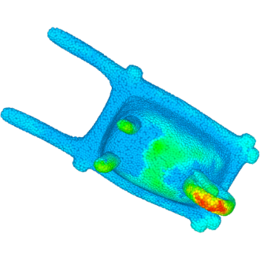
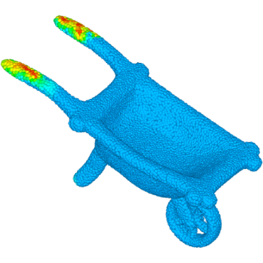
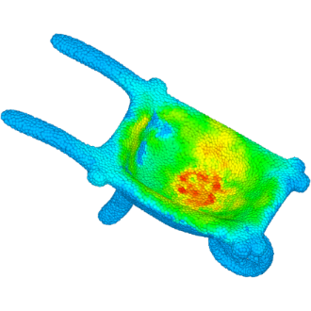
Functional patch
Notes:
For examples, there are three different types of interactions involved for handcarts
For each type of interaction, we extract a functional patch which captures the region of the shape that enables the interaction.
The patches are probability maps.
We show them here with a color map, where red and yellow denote the points with the highest probability of belonging to the patch.

Slide 21

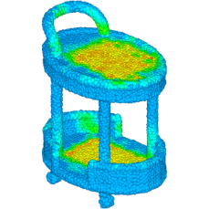
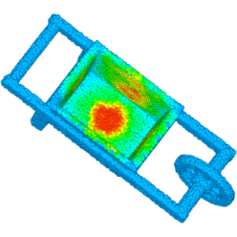
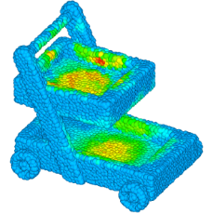

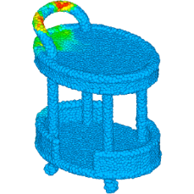
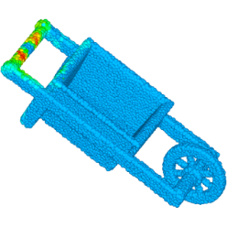
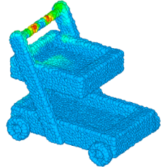

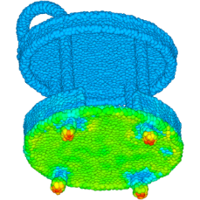
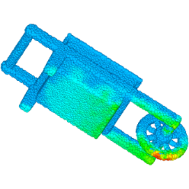
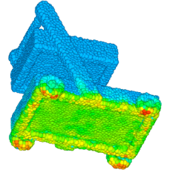
Proto-patch
…
Proto-patch 1
…
Proto-patch 2
…
Proto-patch 3
Notes:
We call the set of all patches in correspondence - a patch prototype, or proto-patch

Slide 22
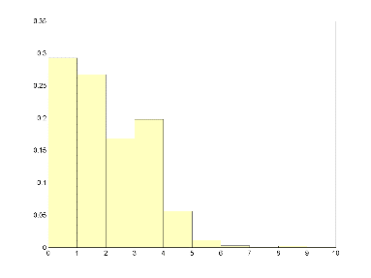
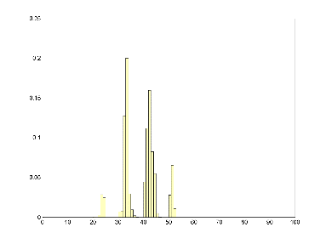
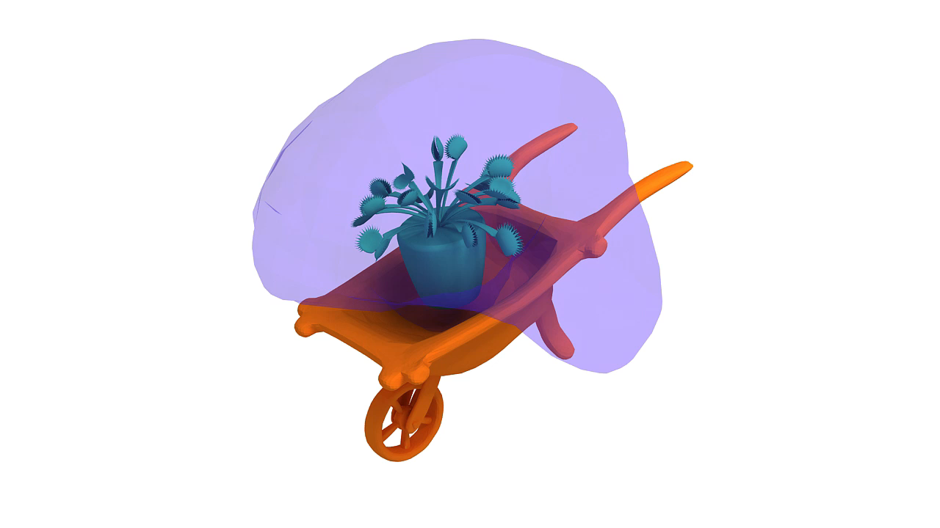

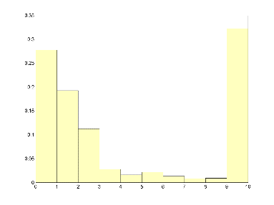
Proto-patch
Unary properties
…
Functional space
Geometric properties
Notes:
Each proto-patch is described by properties related to the geometry and functional space of the corresponding patches.

Slide 23
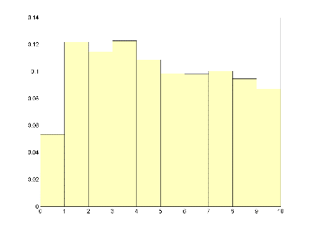


Proto-patch
Binary properties
Geometric properties
Notes:
While the general arrangement of pair of proto-patches is encoded by another set of binary properties

Slide 24












Functionality model
1
Proto-patch
Binary
properties
Unary
properties
Binary
properties
2
Proto-patch
3
Proto-patch
Unary
properties
Unary
properties
Binary
properties
Notes:
Our functionality model is then composed of a set of proto-patches, their properties, and binary properties encoding the relative arrangement of the patches on the shapes.

Slide 25














Prediction
Functionality score
$$ℱ\left( , \right)$$
Notes:
Given the functionality model of a specific category of shapes,
and any unknown shape given in isolation,
We measure how well the given shape supports the corresponding functionality, which is referred as functionality score here.

Slide 26














Prediction
Functionality score
Score = 0.96
Score = 0.92
Score = 0.84
Score = 0.72
Notes:
For example, with respect to the functionality model we trained for the handcart category
This new isolated handcart model and chair model get high functionality scores above 0.9
while the backpack and hanger models with different functionalities get much lower scores.
To compute such score for any unknown shape

Slide 27





Prediction
Functionality score
$$D_{u}$$
$$D_{b}$$
Notes:
We need to predict patches on the shape that match best to the proto-patches in the functionality model,
and the matching is measured by comparing both unary and binary properties.
To perform this prediction, we carry out an iterative optimization where we detect and refine functional patches on the shape.

Slide 28




Prediction
Initial prediction: regression per proto-patch
Notes:
Take this new handcart as an example, to obtain the initial prediction,
we ignore all the binary properties,
but learn a regression model for each proto-patch and estimate the corresponding patch respectively

Slide 29



Prediction
Refinement: constrained optimization
Property space
Notes:
Then, for each patch on the shape, we find a nearest neighbor patch among the proto-patch set and compute the current functionality score
The functionality score is further optimized by refining the functional patches simultaneously

Slide 30
Prediction
Refinement: constrained optimization
Score = 0.95
Property space
Notes:
The refinement process iterates until the functional patches or functionality score converges
As a result, for any new isolated shape without any kind of segmentation, we get the functionality score and the corresponding functional patches as well.

Slide 31
Property weight
Importance of different properties
…
Unary properties
Binary properties
Notes:
Moreover, note that our functionality model consists of a set of different unary and binary properties

Slide 32




Property weight
Importance of different properties
$\sum_{k=1}^{n_{u}}{α_{k}^{u}D_{u_{k}}}$
$$D_{u}$$
$\sum_{k=1}^{n_{b}}{α_{k}^{b}D_{b_{k}}}$
$$D_{b}$$
Notes:
The unary and binary functional distances are linear combinations of the corresponding property distances
So the weights should be different for different properties and also for different categories

Slide 33















Property weight
Objective:
Shape from the model’s category should get higher functionality score than shapes from other categories
$$ℱ\left( , \right)>ℱ\left( , \right)$$
Notes:
To optimize the property weights, our objective is that shapes from the model’s category should get higher functionality scores than shapes from other categories
For example, considering the functionality model of the handcart category, the functionality score of a handcart should be higher than that of a backpack

Slide 34




















Property weight
Metric learning
>
Positive
Negative
Notes:
Thus with a set of shapes belonging to the corresponding category as positive examples
and shapes from other categories as negative examples
We optimize the property weights by solving a metric learning problem

Slide 35
Learning
Regression model
Constrained optimization
Positive
within context
Initial functional patches
Optimal property weights
Refined functional patches
（
）
Negative
Training data
Metric learning
Notes:
To summarize, to train the full functionality model,
the training data should consist of a set of positive examples, which are shapes from the corresponding category provided in scene contexts,
and a set of negative examples, which are isolated shapes from other categories
The positive examples are first used to predict the initial functional patches on all the training shapes,
Then the patches are used to optimize the property weights,
and this process is repeated with the refined patches
until the weights converge.
During the whole process, three different types of optimizations are performed.
For the initial prediction, a regression model is learned for each proto-patch
The property weights are optimized via metric learning
and patches are refined by solving a constrained optimization problem.

Slide 36
Prediction
Regression model
Constrained optimization
Positive
within context
Initial functional patches
Optimal property weights
New
isolated shape
Refined functional patches
（
）
Negative
Training data
Metric learning
Notes:
To use our trained functionality model for prediction,
the input will now become new isolated shapes,
With the optimized property weights,
the whole prediction process simply consist of two steps: initial prediction and refinement.

Slide 37















Dataset
15 categories, 608 scenes
49
43
40
45
49
35
10
45
41
32
47
41
44
42
45
Notes:
To extensively evaluate our functionality model, we construct a dataset of scenes composed of manmade objects,
and further group these scenes into 15 different categories according to the primary functionality of the central object,
each category has 10-50 scenes with 608 scenes in total

Slide 38

















Prediction
Score = 0.97
Score = 0.96
Score = 0.94
Score = 0.97
Score = 0.97
Score = 0.95
Notes:
Here we show some prediction results on basket category with two different types of interactions.
And here are more results on TV bench category with three different types of interactions
Look how the shapes that get higher scores are functionally similar to the category, although their geometry and topology are quite different

Slide 39
Applications
Notes:
Now I will show several functionality-aware applications

Slide 40










Object recognition
Bicycle
Drying Rack
Notes:
Based on the functionality score estimation, the most direct use of our model is object recognition

Slide 41

Category correlation
Chair-Chair
Chair-Handcart
Desk-Table
Desk-TV bench
Hanger-Desk
Notes:
To demonstrate how well our models discover the functionality of different categories,
we compute the amount of correlation between the classes.
Categories with similar functionality will be more correlated, with shapes of both classes having a high functionality score to each category.
such as chair with chair, chair with handcart, desk with table and tv bench,
while categories like hanger and desk that have quite different functionalities will have much lower correlations

Slide 42



Functional similarity
Functionality score to each category
Support similar functionalities $⇒$ functionally similar
Chair | Handcart | Hook | … | Stroller | …
0.999 | 0.972 | 0.71 | … | 0.90 | …
0.982 | 0.988 | 0.73 | … | 0.993 | …
Notes:
We can also derive a measure to assess the functional similarity between two objects.
For any given shape,
we can verify how well the object supports the functionality of each category .
Intuitively, if two objects support more similar types of functionalities, then they should be functionally more similar,
For example the chair and stroller shown here are functionally similar since they share three same types of functionalities.

Slide 43



Functional similarity
2D embedding
Ours
LFD
Notes:
Here is the 2D embedding of all the central objects in our dataset based on our functional similarity measure
and here is the 2D embedding using geometric shape descriptor light field distance
Shapes from different categories are shown using different marks.
We can see how well the shapes are distributed into separate clusters using our measure
For example, for dying racks represented using purple triangles here, our distribution is much more concentrated

Slide 44






Multi-function
Scale down
Scale up
Scale up
Scale up
Notes:
Without having any assumption on the physical size of the given shape, we can explore more possible functionalities of the shape
For example, for this input chair model, we can not only be able to recognize it as a chair,
But also identify it as hanger, handcart, desk and drying rack under different poses and with different scales

Slide 45





Multi-function
Inspiring designs
Drying Rack
Basket
Stroller
Vase
Notes:
We believe that this type of exploration can potentially inspire users with interesting designs
For example, this drying rack-like basket and stroller-like vase.
We can even find similar designs in real life!

Slide 46













Function enhancement
Notes:
With the localization of functional patches and their neighbors identification,
we can also guide users in enhancing the functionality by transferring the patches
For example to make this chair model better support the functionality of handcart.

Slide 47




Functional hybrid
Notes:
We can even use the functional patches to guide users in creating functional hybrids
For example, here we use vase to replace one leg of the table to create a vase-table that simultaneously support the functionality of two categories.

Slide 48
Conclusion
Notes:
In conclusion,

Slide 49
















Conclusion
Functionality model
How via common object-to-object interactions
Where via functional patch localization
Enable various functionality-aware applications
Score = 0.95
Notes:
we provide a new method to learn the functionality model of a object category.
Our model focus on how via common object-to-object interactions
and where via functional patches localization.
With the learned functionality models, various functionality-aware applications are made possible.

Slide 50

Limitation & future work
Analysis entirely based on geometry
Other aspects like material
Notes:
In terms of limitations and future works,
Our functionality analysis is entirely based on reasoning on the geometry of shapes.
As a result, our model could recognize a backpack as a vase as shown here.
Other aspects like material of the shape is also very important for functionality understanding and should be taken into consideration in the future.

Slide 51



Limitation & future work
Analysis entirely based on geometry
Other aspects like material
Static configurations of object interactions
Dynamic interactions
Notes:
Moreover, our functionality analysis is limited to extracting information from static configurations of object interactions.
It would be an entirely new pursuit to understand functionality by observing and learning from dynamic interactions.

Slide 52




Thank you!
Source code & data are available at
http://vcc.szu.edu.cn
ACKNOWLEDGMENTS
Anonymous reviewers & funding from
NSFC, 973 Program, ISF-NSFC
Notes:
Finally, dataset and source code are available at our project page, welcome to download and try! [click]
I’d like to thank the anonymous reviewers for their suggestions and our funding agencies [click]
And thank you for your attention!

Slide 53
Appendix

Slide 54

Evaluation
Ranking consistency (RC)
The preservation of a ranking of shapes ordered by their functionality scores (inside > outside)
$$RC\left(ℳ\right)= \frac{\# correctly ordered pairs}{\# diresed ordered pairs }$$
Notes:
This requirement is equivalent to asking for the preservation of a ranking of shapes ordered by their distance, where the first shapes that appear in the ranking are of the same class as the model.

Slide 55


Evaluation
Ranking consistency (RC)
The preservation of a ranking of shapes ordered by their functionality scores (inside > outside)
Notes:
This requirement is equivalent to asking for the preservation of a ranking of shapes ordered by their distance, where the first shapes that appear in the ranking are of the same class as the model.

Slide 56


Evaluation
PR-curve
Comparing to LFD and ICON
Notes:
This requirement is equivalent to asking for the preservation of a ranking of shapes ordered by their distance, where the first shapes that appear in the ranking are of the same class as the model.

